Slide 1

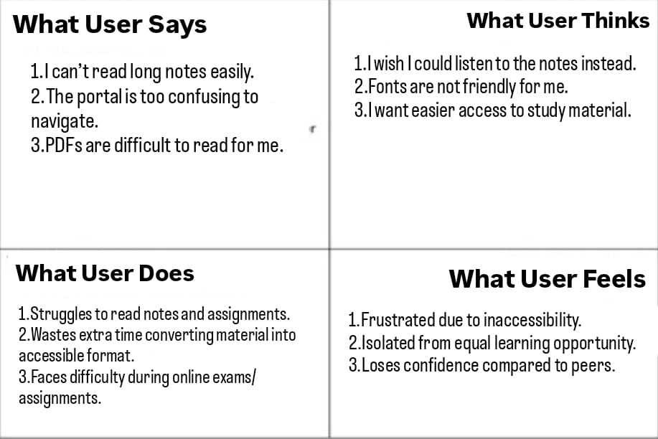
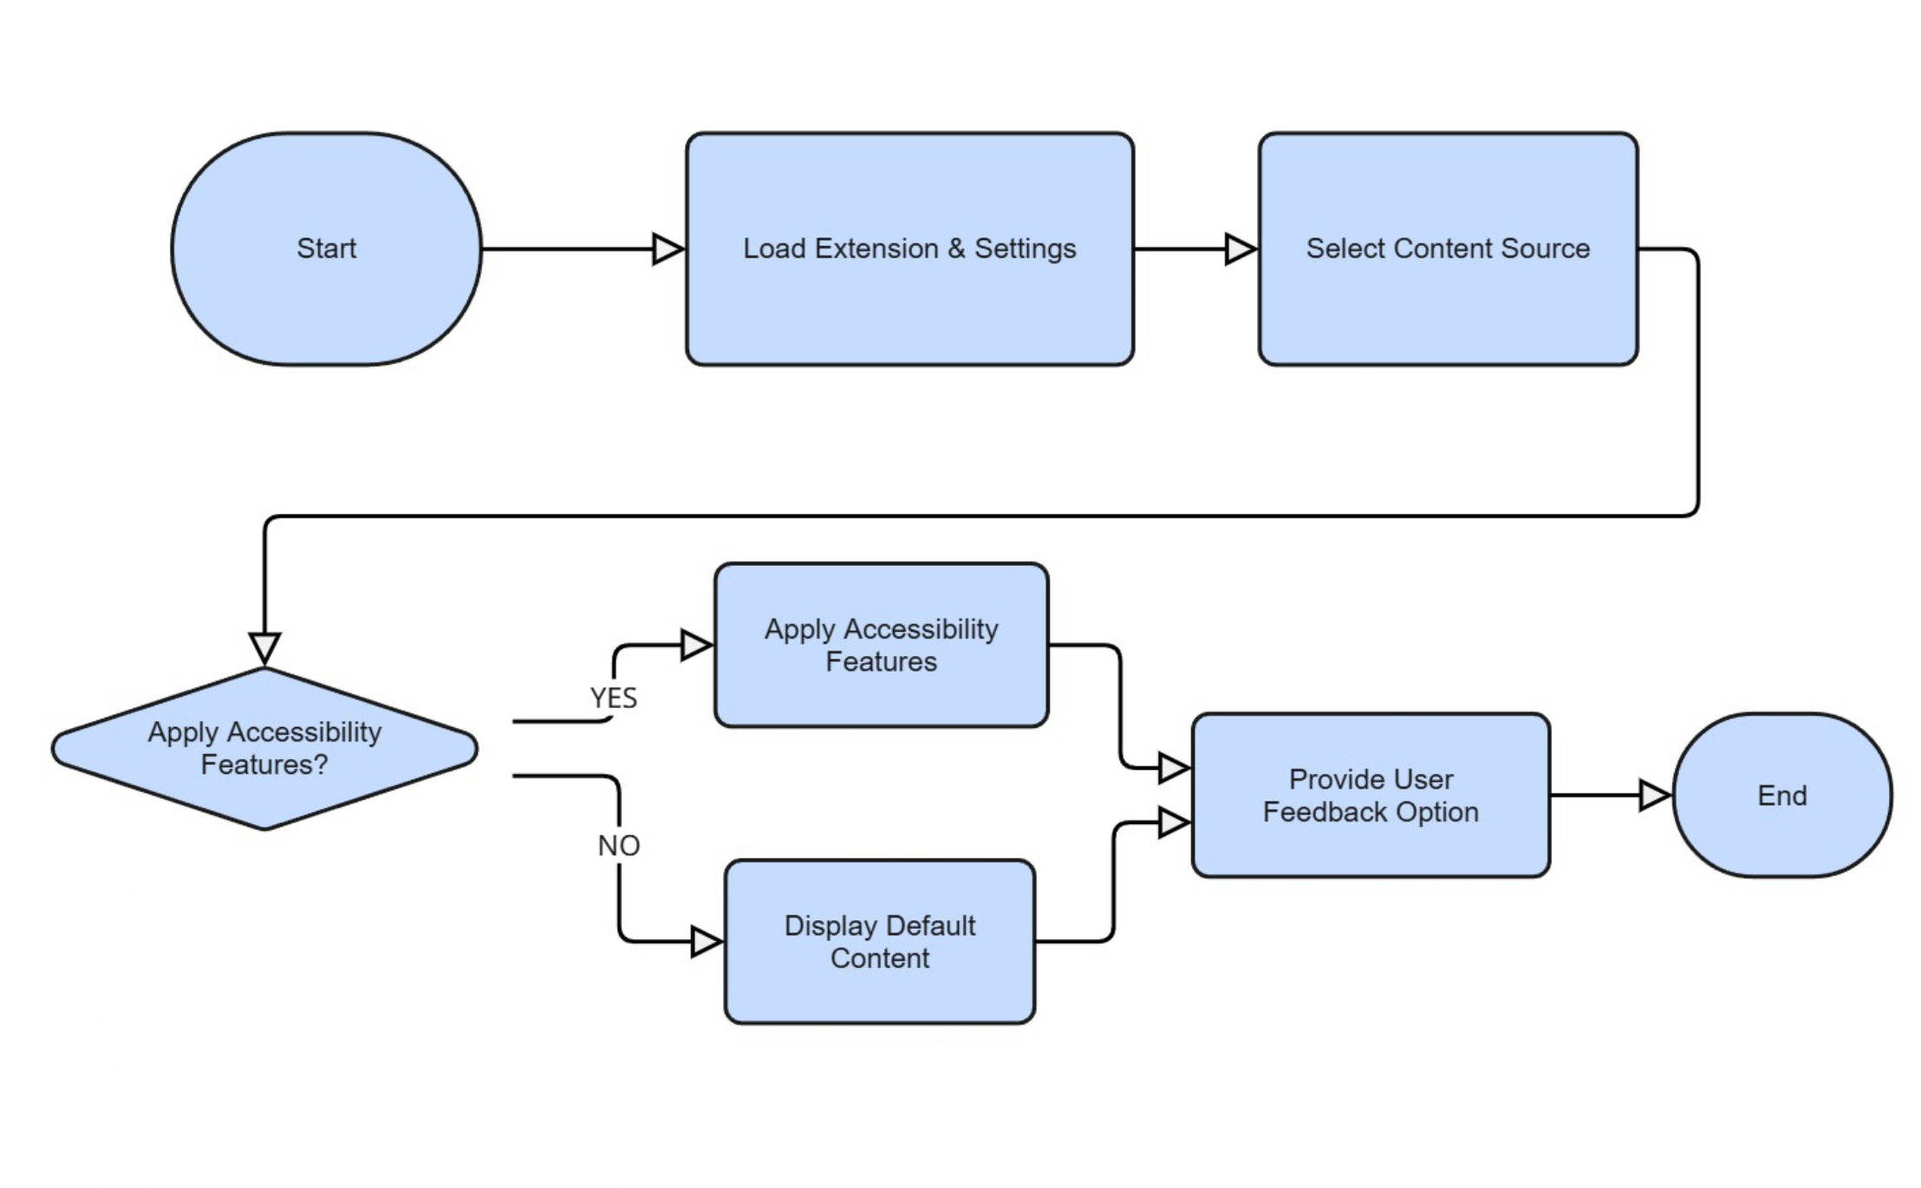
Proposed Architecture/ Diagram:
MIT SCHOOL OF COMPUTING
Group Id:
TY-CORE223
DEPARTMENT OF COMPUTER SCIENCE & ENGINEERING
Accessibility Enhancer: Web/Voice Support for Disabled Students
Amol Dodmani,Om Bhandari
Faculty Guide:
PROF. POOJA PAWALE
SR NO | Requirement | Proposed Solution
1. | Access to web content for visually impaired | Implement Text-to-Speech using the Web Speech API to read aloud website text.
2. | Accessibility of PDF notes | Use PDF.js (or similar libraries) to extract text and convert it into speech.
3. | Personalization for different disabilities | Add customizable settings for font size, themes, and voice options.
user
Problem Statement:-
Many college portals and study resources are not accessible to students with disabilities such as visual impairment or dyslexia. These students face difficulties in reading, navigating portals, and accessing notes. customizable This creates a barrier to inclusive education and impacts their academic performance and confidence.
Proposed Solution:
Develop a browser extension/app that:
Reads aloud content
2. Converts PDF notes into audio for easy listening.
3. Provides dyslexia-friendly fonts & color contrast for readability.
4. Enables voice-based navigation for smoother portal access..
Scope and Feasibility:
-Helps visually impaired and dyslexic students immediately.
-Scalable to schools, universities, and workplaces.
-Can integrate with Learning Management Systems (LMS) like Moodle, Google Classroom, or custom portals.

